Slide 1


Slide 2
About Today…
Intro to Networking
Overview of HTTP
Creating Simple HTTP Server
Sending response

Slide 4
Networking
Definition
Networking involves connecting computers and other devices to share resources and data
Importance
Key for building web applications, allowing communication between clients and servers

Slide 5

What do you think networking enables in web development?

Slide 6
Overview of HTTP
Definition
HyperText Transfer Protocol (HTTP) is the foundation of data communication on the web
Key Concepts
Requests
Responses
Methods
Status Codes

Slide 7
Request
Message sent by a client to initiate an action on the server
Request Line
Contains :
HTTP method (e.g., GET, POST)
resource URL
HTTP version
Headers
Provide metadata about the request, such as :
content type
authorization
etc
Body
Contains data sent to the server
(primarily used in methods like POST and PUT)

Slide 8
Response
Messages sent by the server in response to an HTTP request
Status Line
Contains :
HTTP version
Status code (e.g., 200, 400, 500)
Status message
Headers
Provide metadata about the response, such as :
content type
content length
etc
Body
Contains data sent back to the client
(HTML content, JSON data, etc)

Slide 9
HTTP Method
Indicate the desired action to be performed on the server
GET
Purpose
Retrieve data from the server
Example
Fetching a webpage or an API endpoint
Characteristics
Only retrieve data and should not have any other effect on the data
POST
Purpose
Send data to the server to create a new resource
Example
Submitting a form or uploading a file
Characteristics
The data sent to the server is included in the body of the request
PUT
Purpose
Send data to the server to update an existing resource
Example
Updating a user profile or modifying a document
Characteristics
Data sent to the server replaces the current representation resource
DELETE
Purpose
Remove a resource from the server
Example
Deleting a user account or removing a post
Characteristics
It should remove the specified resource

Slide 10
HTTP Status Codes
Indicate the result of the request
1xx
Informational:
Request received and continuing process
Example
100 Continue
2xx
Success
Request successfully received, understood, and accepted
Example
200 OK: The request was successful
3xx
Redirection
Further action needs to be taken to complete the request
Example
301 Moved Permanently: The resource permanently moved to a new URL
4xx
Client Errors
The request contains bad syntax or cannot be fulfilled
Example
400 Bad Request: The server don’t understand request due to invalid syntax
5xx
Server Error
The server failed to fulfill a valid request
Example
500 Internal Server Error: The server encountered an unexpected condition
that prevented it from fulfilling the request

Slide 11
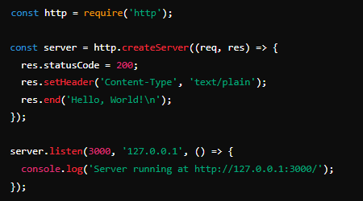
Creating a Simple HTTP Server
Node.js provides perfect way to provide the networking capability
Create server and make it capable to handle incoming requests

Slide 12
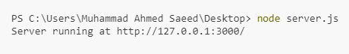
Accessing Server
Open your terminal
Run server with the command
Open a browser and navigate to http://127.0.0.1:3000/

Slide 13
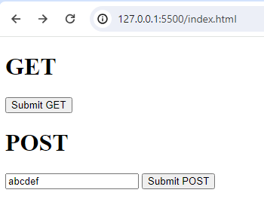
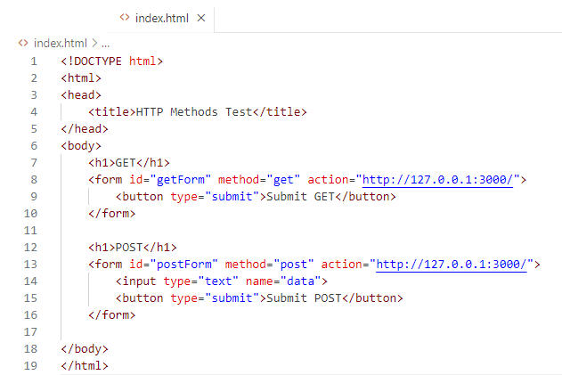
Sending Request to Server

Slide 14
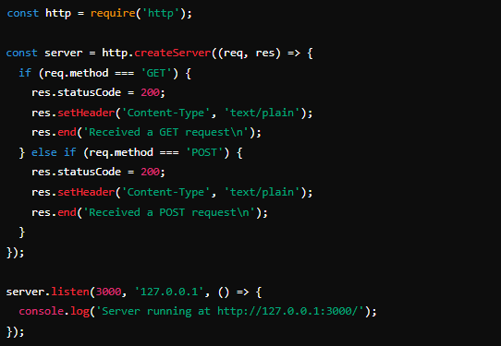
Handling HTTP Request

Slide 15
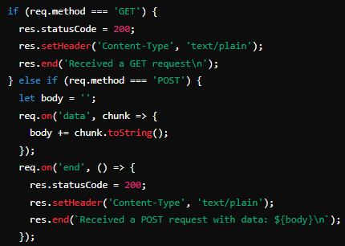
Receiving data from client

Slide 16
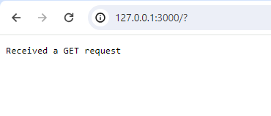
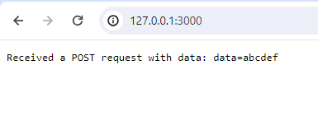
Displaying data on client browser

